Slide 1
SURVIVAL RATIO PLOTS
Victor

Slide 2
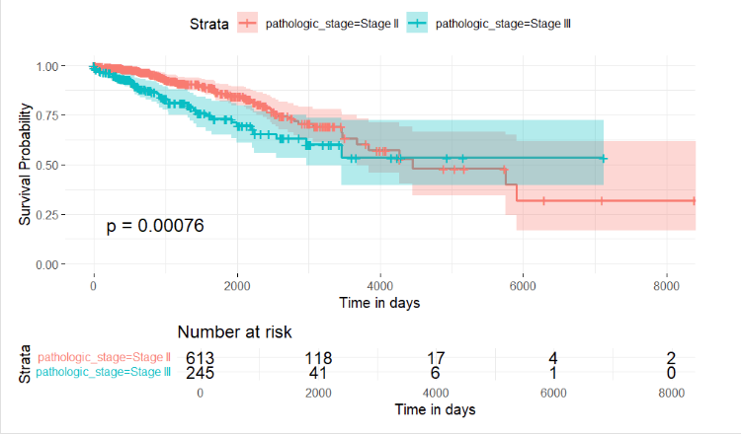
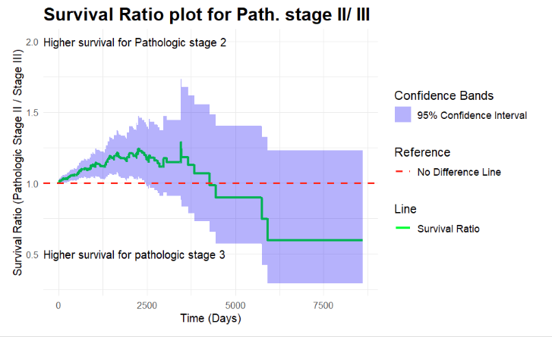
Comparison of survival between Pathologic stage II and III

Slide 3
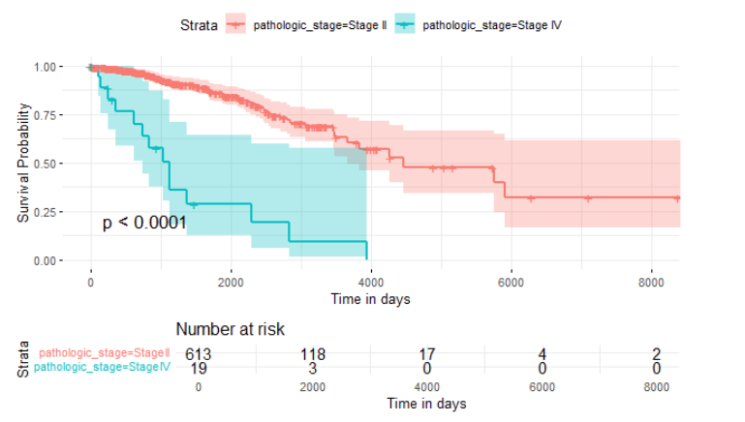
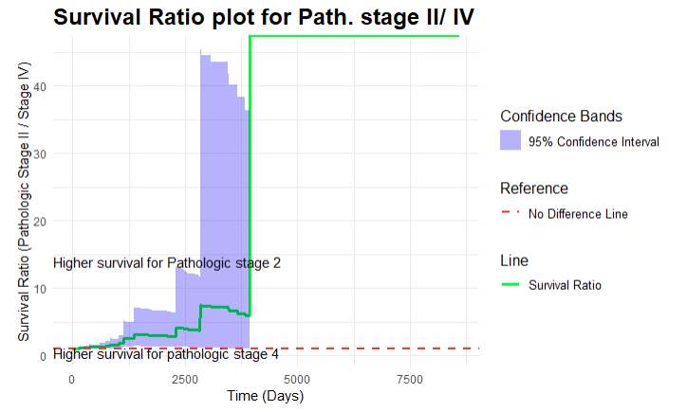
Comparison of survival between Pathologic stage II and IV

Slide 4
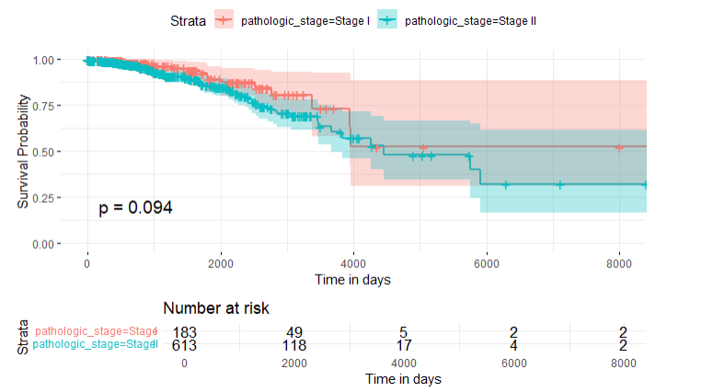
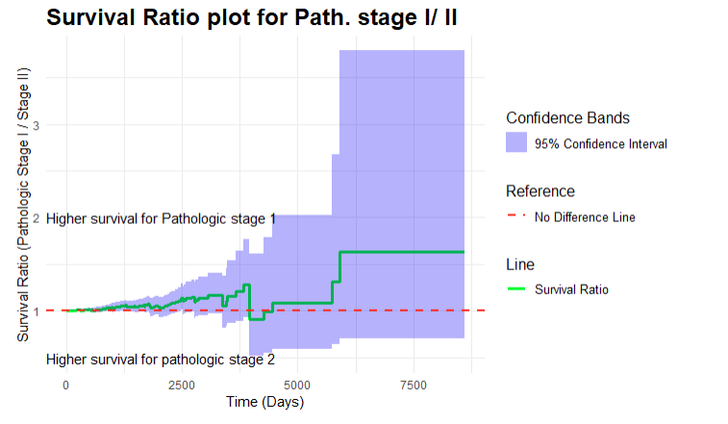
Comparison of survival between Pathologic stage I and II

Slide 5
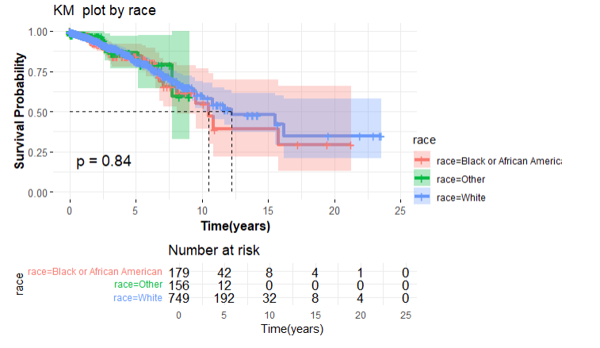
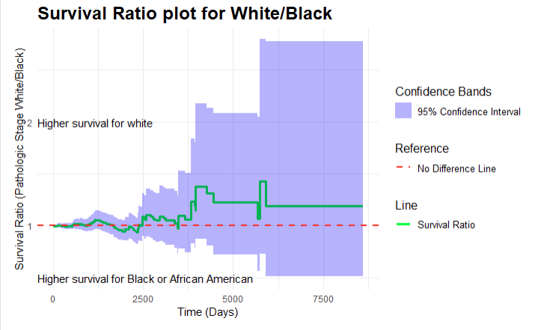
Comparison of Survival by Race

